Slide 1
Lecture 8
Requirements Analysis:
  Requirement Modeling Techniques
BSCS (Software Engineering-I) SZABIST-Islamabad

Slide 2
Requirements Analysis
Requirements analysis
  Specifies software’s operational characteristics
  Indicates software's interface with other system elements
  Establishes constraints that software must meet
  Elaborate on basic requirements established during earlier requirement engineering tasks
  Build models that depict user scenarios, functional activities and their relationships, system and class behavior, and the flow of data as it is transformed.
BSCS (Software Engineering-I) SZABIST-Islamabad

Slide 3
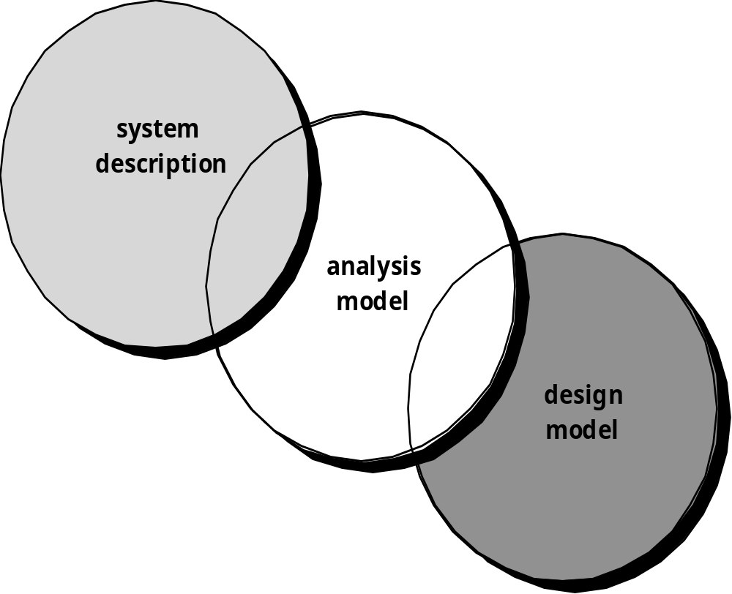
A Bridge
BSCS (Software Engineering-I) SZABIST-Islamabad

Slide 4
Goals of Modeling
Provides the first technical representation of a system
Is easy to understand and maintain
Deals with the problem of size by partitioning the system
Uses graphics whenever possible
Differentiates between essential information versus implementation information
Helps in the tracking and evaluation of interfaces
Provides tools other than narrative text to describe software logic and policy
BSCS (Software Engineering-I) SZABIST-Islamabad

Slide 5
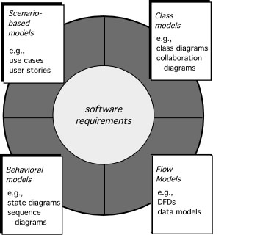
Elements of Requirements Analysis
BSCS (Software Engineering-I) SZABIST-Islamabad

Slide 6
A Set of Models
Scenario-based modeling/interaction – represents the system from the user's point of view
Flow-oriented modeling/context – provides an indication of how data objects are transformed by a set of processing functions
Class-based modeling/structural – defines objects, attributes, and relationships
Behavioral modeling – depicts the states of the classes and the impact of events on these states
BSCS (Software Engineering-I) SZABIST-Islamabad

Slide 7
Rules of Thumb
The model should focus on requirements that are visible within the problem or business domain. The level of abstraction should be relatively high.
Each element of the analysis model should add to an overall understanding of software requirements and provide insight into the information domain, function and behavior of the system.
Delay consideration of non-functional models until design.
Minimize coupling throughout the system.
Be certain that the analysis model provides value to all stakeholders.
Keep the model as simple as it can be.
BSCS (Software Engineering-I) SZABIST-Islamabad

Slide 8
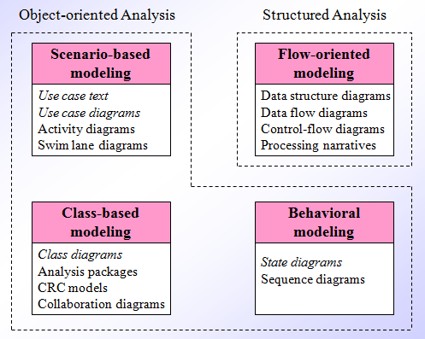
Analysis Modeling Approaches
BSCS (Software Engineering-I) SZABIST-Islamabad

Slide 9
Scenario-Based Modeling/ Interaction Modeling
Interaction models shows the interaction between the components of a system, or between the system being developed and other systems (or users).
Modeling user interaction is important as it helps to identify user requirements.
Modeling system to system highlights the communication problems that may arise.
Examples of Interaction Modeling diagrams are
  Use Case Diagram
  Activity Diagram
  Swim lane Diagram
BSCS (Software Engineering-I) SZABIST-Islamabad

Slide 10
Use-Cases Diagram
Use-cases diagram are simply an aid to defining what exists outside the system (actors) and what should be performed by the system (use-cases).”
A Usecase diagram consist of Use cases and actor.
BSCS (Software Engineering-I) SZABIST-Islamabad

Slide 11
Use-Cases
The activity performed by the system in side the system is called Use-cases.
Example: In Library Information System uses cases could be Search, Borrow, Return, etc.
BSCS (Software Engineering-I) SZABIST-Islamabad

Slide 12
Actor
Actors represent roles people or devices play as the system functions
Users can play a number of different roles for a given scenario.
Actor is someone or something interacting with use case.
Actor triggers use case.
Each actor must be linked to a use case, while some use cases may not be linked to actors.
Actor –use case: Actor has responsibility toward the system(inputs), and actor have expectations from the system (outputs).
Example: LIS: User is actor and Librarian is an actor
Example: ATM: User, Technician and Bank are actors
BSCS (Software Engineering-I) SZABIST-Islamabad

Slide 13
Use-Cases Writing
It is effective to use the first person “I” to describe how the actor interacts with the software
Format of the text part of a use case
Use case name and identifier (unique identifier and short name of the use-case)
Objective - What is the ultimate objective of the use-case. What is it trying to achieve?
Input – What will be the input to the system
Output – What will be the output of the system
Actors - Who is involved in the use-case? Which actors/stakeholders?
Flow of Events
  Basic Flow - flow of events normally executed in the use-case
  Alternative Flow - a secondary flow of events due to infrequent conditions
  Exceptions - Exceptions that may happen during the execution of the use case
Includes (other use case IDs)
Preconditions - Any condition that must be satisfied before the use case begins
Post conditions - The conditions that will be satisfied after the use case successfully completes
Notes/Issues - Any relevant notes or issues that need to be resolved
BSCS (Software Engineering-I) SZABIST-Islamabad

Slide 14
Use-Cases Example
Use Case 18: SC Login
Name: SC Login
Goal: SC wants to log into the system.
Input: SC will enter user name and password.
Output: login successfully.
Main Scenario: This use case describes how the SC log into the system.
Pre-condition: The SC opens the login page.
Steps:
Step1: The SC enters his login id and password.
Step 2: If the login and password is valid, a session is opened.
The security is verified.
The specific page is loaded.
Step 3: If the login or password is not valid, the login screen is redisplayed with an error message.
Post-condition: Home page of the system will be shown to the SC.
Exceptional Scenario 1: If SC is not registered then he can’t login to ASCP System.
Example: Dr. Imran wants to login ASCP he should be registered as SC. Then he will click on login button.
He will enter his username and password. Dr. Imran is login to system.
BSCS (Software Engineering-I) SZABIST-Islamabad

Slide 15
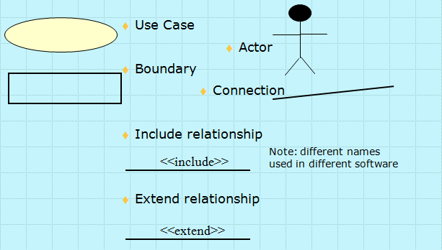
Use-Case Diagram Components
BSCS (Software Engineering-I) SZABIST-Islamabad

Slide 16
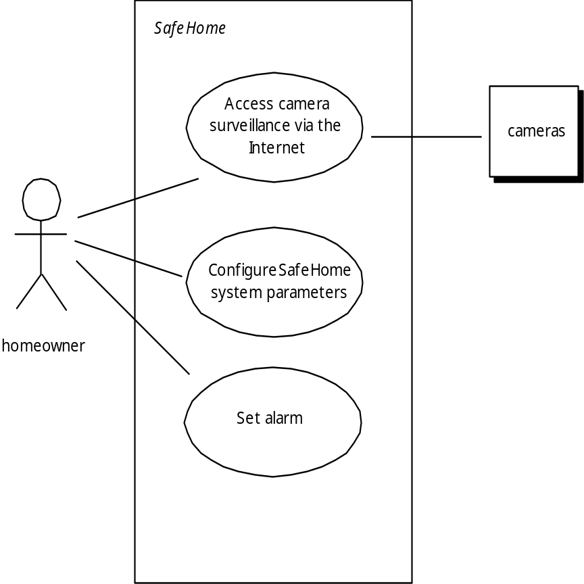
Use-Case Diagram
BSCS (Software Engineering-I) SZABIST-Islamabad

Slide 17
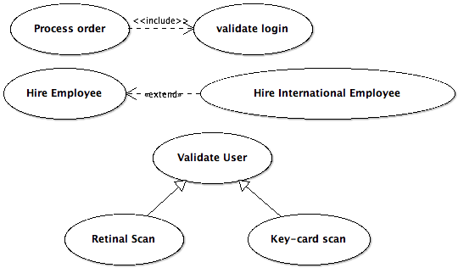
Use Case Relationships
Includes
Extends
Generalization
BSCS (Software Engineering-I) SZABIST-Islamabad

Slide 18
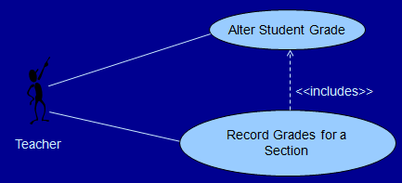
Use Case Relationships
Includes Dependency: Defines how one use case can invoke behavior defined by another use case
BSCS (Software Engineering-I) SZABIST-Islamabad

Slide 19
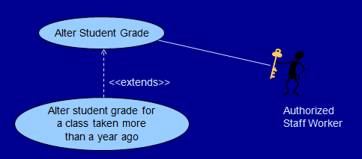

Use Case Relationships
Extends dependency: defines a use-case that is a variation of another, usually for handling an abnormal situation.
Extend is a directed relationship that specifies how and when the behavior defined in usually supplementary (optional) extending use case can be inserted into the behavior defined in the extended use case.
Example: Registration use case is complete and meaningful on its own.
It could be extended with optional Get Help On Registration use case.
BSCS (Software Engineering-I) SZABIST-Islamabad

Slide 20
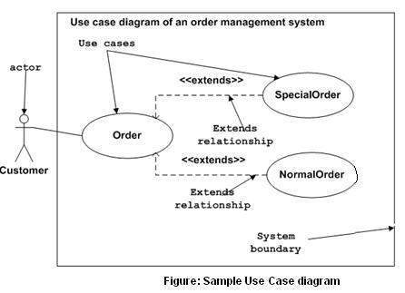
Use-Case Diagram
BSCS (Software Engineering-I) SZABIST-Islamabad

Slide 21
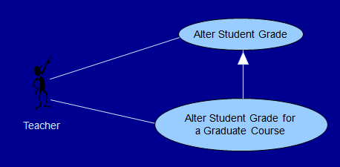
Use Case Relationships
Generalization: Defines one use case as a generalization of another.
BSCS (Software Engineering-I) SZABIST-Islamabad

